Slide 1
New Html E-Learning Player
Description :
This is shell is developed in html5 which will synchronize the html data with provided audio, based on audio timer.
How it Works ?
It sync the audio and html with help of data attribute which is a html attribute. We have to declare data-slide-time to the html element which we want to synch with audio. This data-slide-time attribute will have one parent element which consist a class audio-slides. The audio-slide class will help to find the data-slide-time attribute and send it the data to player console.
The content will not appear until and unless the audio will to reach to its corresponding mentioned time.
-Udey

Slide 2
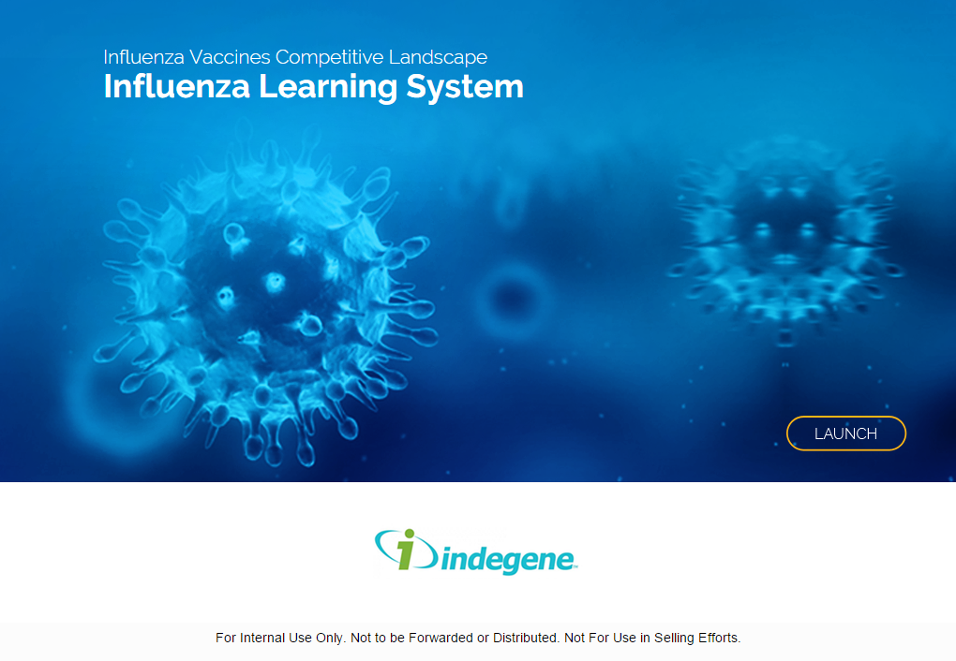
New Html E-Learning Player >> Skinning of player
Step1 : Launch screen skinning, what need to change in launch screen
Course name
Module name
Launch image
Launch button Image
Client logo
Footer of launch page
-Udey

Slide 3
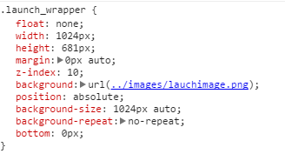
New Html E-Learning Player >> Skinning of player
Step2 : How to change the launch image of the player. There are two way to change the launch image .
1. using css.
2. using image replacement.
Using CSS - Go to shellbinder.css find a class launch_wrapper and change the image name.
There
-Udey

Slide 4
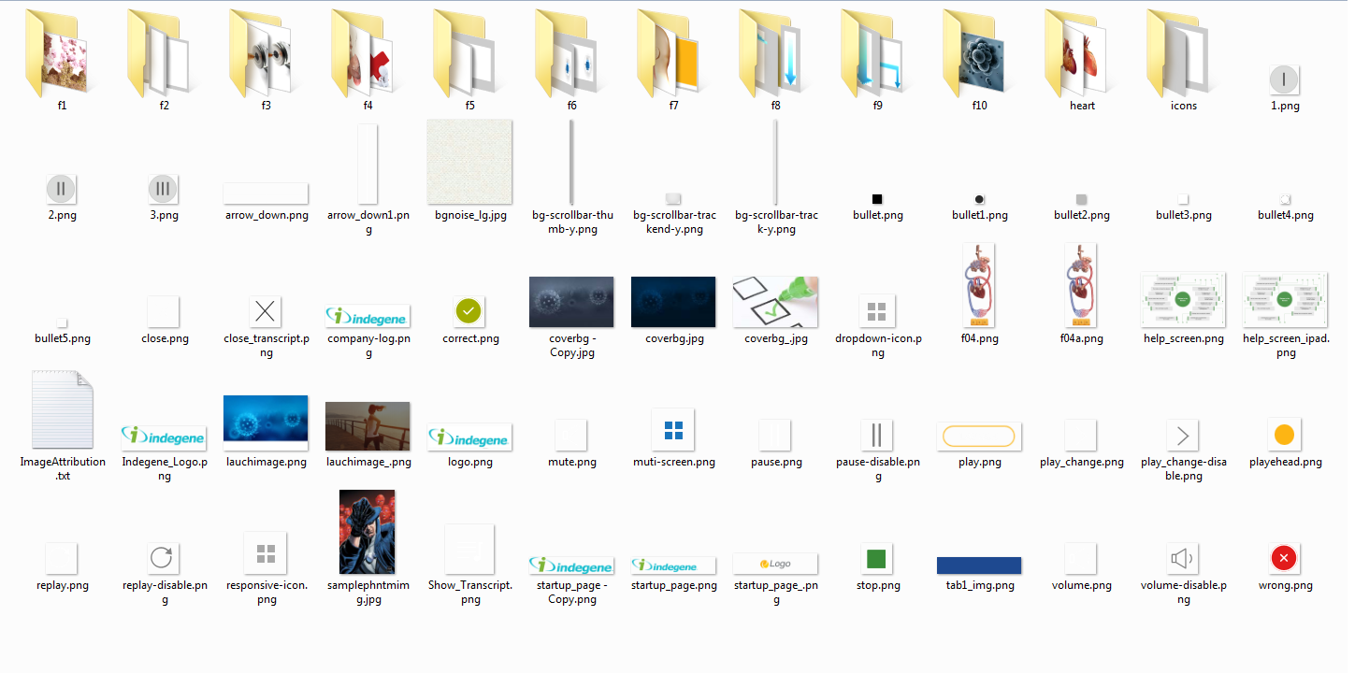
New Html E-Learning Player >> Skinning of player
Step3 : How to change the launch image of the player. There are two way to change the launch image .
2. Using CSS - Go to image folder rename your image file as per existing launch image and replace it with same .
This Image
-Udey

Slide 5
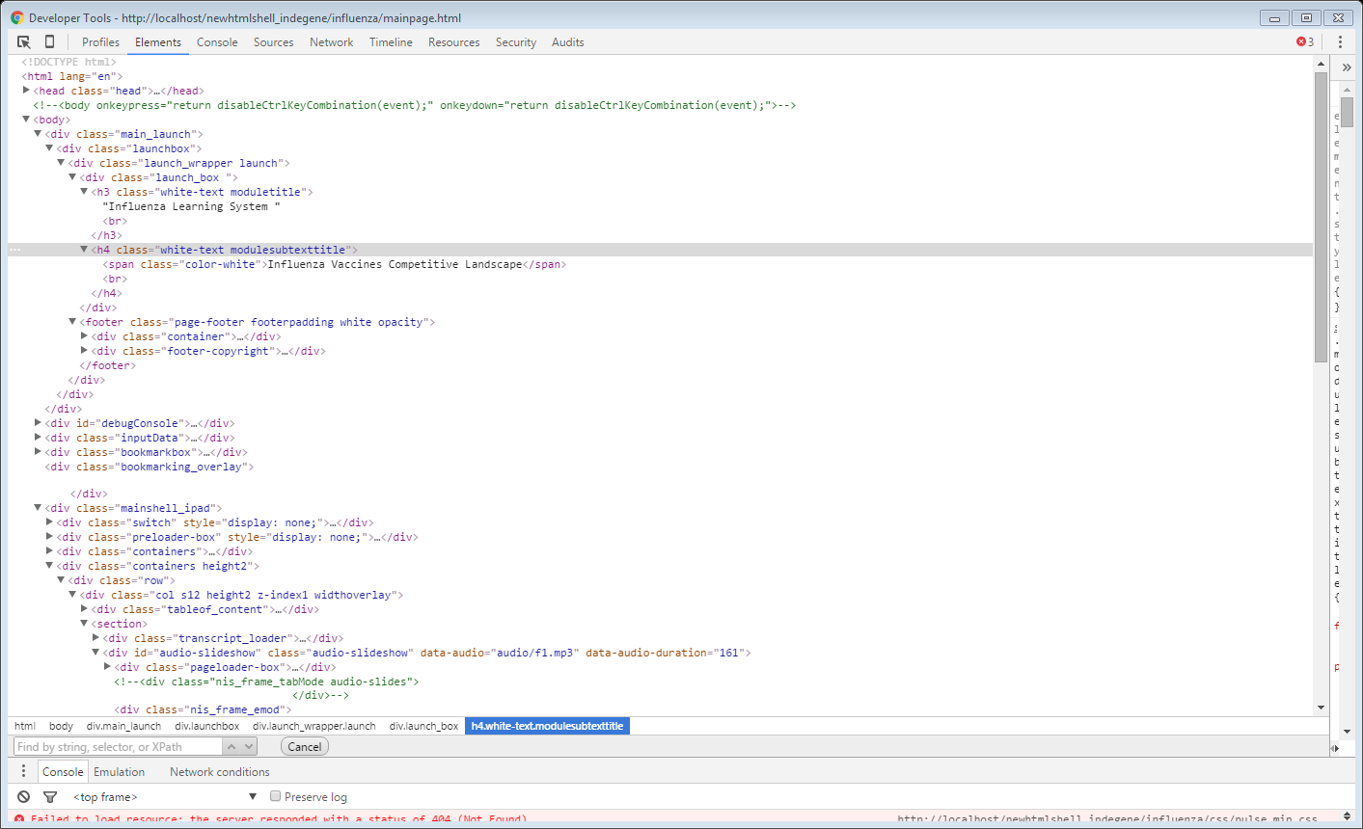
New Html E-Learning Player >> Skinning of player
Step3 : Change course name and module name.
Go to index.html find two class :
moduletitle
modulesubtexttitle
-Udey

Slide 6
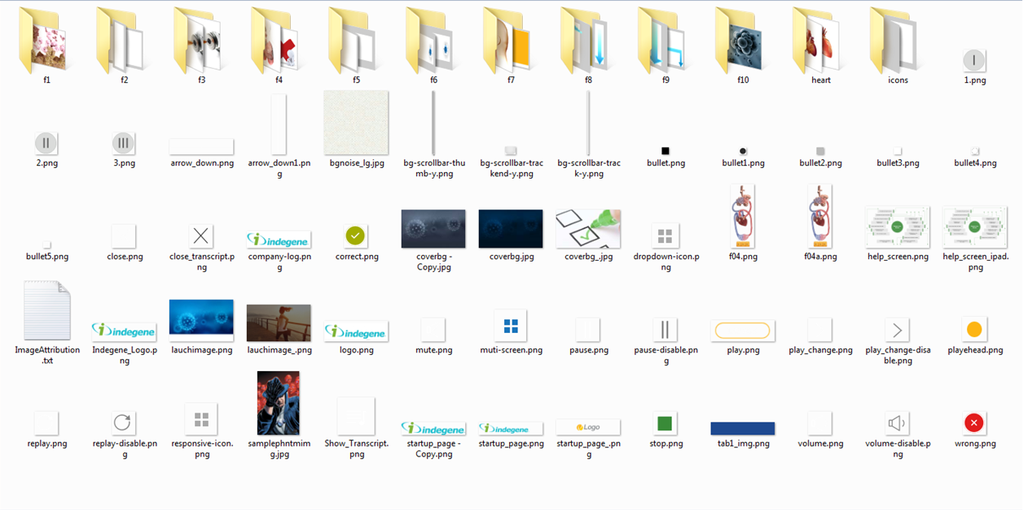
New Html E-Learning Player >> Skinning of player
Step4 : Replacing a client logo
Rename your file as same name of logo image and replace the same.
-Udey

Slide 7
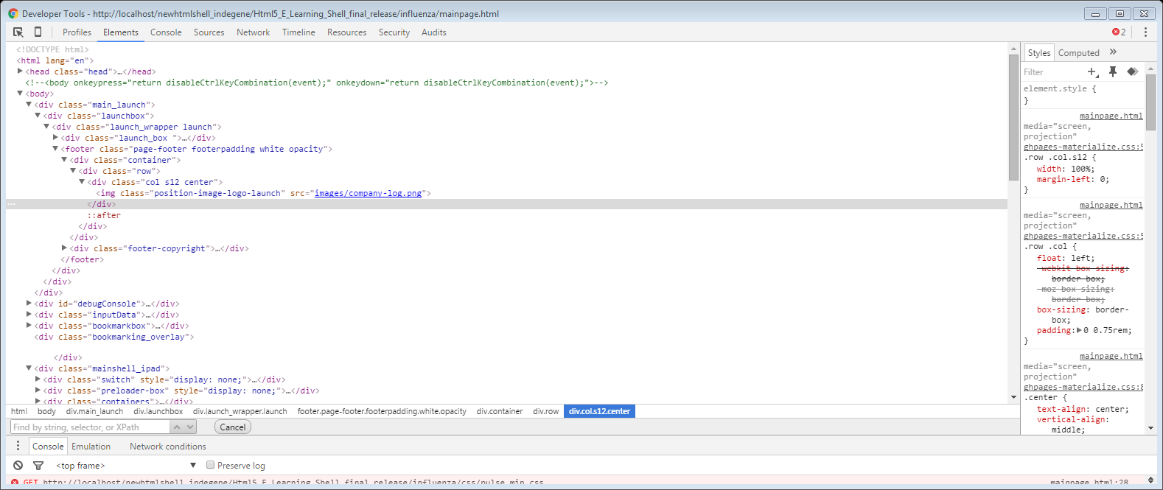
New Html E-Learning Player >> Skinning of player
Step5 : Change footer background color.
Go to index.html and find a class footer-padding and color of the footer .
-Udey

Slide 8
New Html E-Learning Player >> Skinning of player
Step6 : Change Play or Launch button.
Go to images folder and change the replace the play button image file with you file.
-Udey

Slide 9
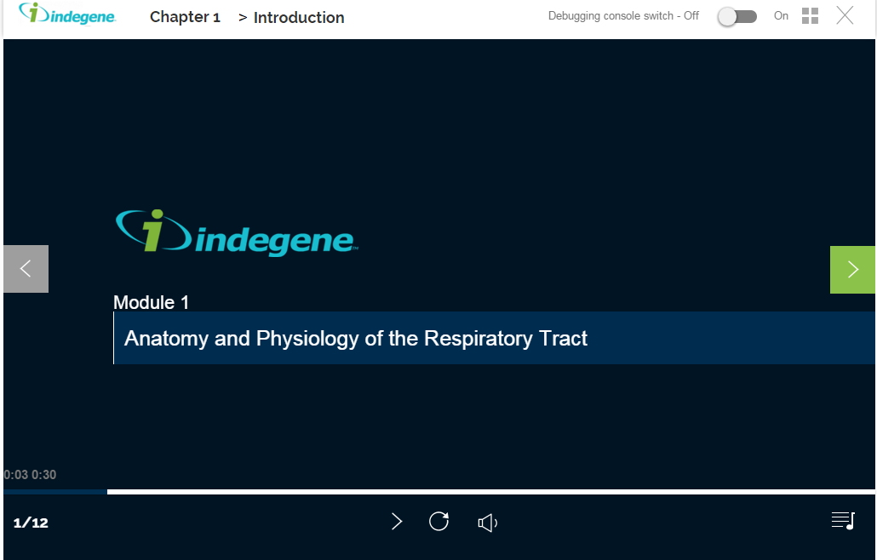
New Html E-Learning Player >> Skinning of player
Step6 : Skinning header and footer.
Replace header logo image and control icons of the player.
-Udey

Slide 10
New Html E-Learning Player >> Audio and html Synching
Synchronization of audio and html together.
How to do ?
In every page we need to callback a function on ready of the document.
<script>
$(document).ready(function(){
$('#audio-slideshow').udSynch();
});
</script>
Copy the above code and paste it in <head> part of the other pages except the index.html.
If the code is not placed then synching will not work.
-Udey

Slide 11
New Html E-Learning Player >> Audio and html Synching
Synchronization of audio and html together.
How to do ?
Scenario 1: Suppose audio has some text/ image need to appear in 10 seconds. Then you need to place the particular time inside the attribute (data-slide-time=“10”). Before doing it, you have to check whether it has parent class(audio-slides).
Example :
<div class=“audio-slides”>
<div data-slide-time=“10”>
<p>Hello World</p>
<img src=“images/one.png”>
</div>
</div>
-Udey

Slide 12
New Html E-Learning Player >> Audio and html Synching
Synchronization of audio and html together.
How to do ?
Scenario 2: Suppose you want to show the one content till end of the audio and want to show some textual or graphical content on it. Then just put one class show-previous on next audio-slide class.
Example :
Previous slide
<div class=“audio-slides”>
<div data-slide-time=“10”>
<p>Hello World</p>
<img src=“images/one.png”>
</div>
</div>
Next slide
<div class=“show-previous audio-slides”>
<div data-slide-time=“12”>
<p>Hello World2</p>
</div>
</div>
-Udey

Slide 13
New Html E-Learning Player >> Audio and html Synching
How to add animation.
Example : To add animation we need to add a class called “animated” with animation name e.g – fadeIn, fadeOut etc.
Previous slide
<div class=“audio-slides”>
<div class=“animated fadeIn” data-slide-time=“10”>
<p>Hello World</p>
<img src=“images/one.png”>
</div>
</div>
Next slide
<div class=“show-previous audio-slides”>
<div class=“animated fadeIn” data-slide-time=“12”>
<p>Hello World2</p>
</div>
</div>
-Udey

Slide 14
New Html E-Learning Player >> Audio and html Synching
Create JS : How to implement.
Use Iframe and call the url of create js inside it.
Example :
<div class=“animated fadeIn” data-slide-time=“0”>
<iframe class="block" src="createjs/video1.html" frameborder="0" scrolling="no"></iframe>
</div>
-Udey

Slide 15
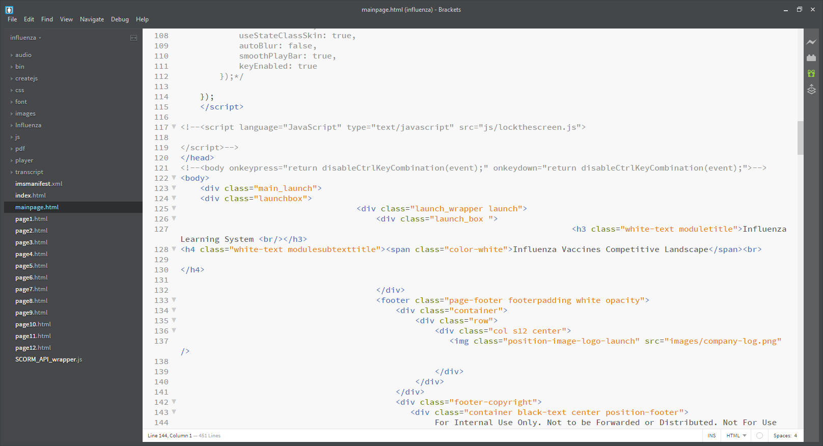
New Html E-Learning Player >> Release time after QA
Minify the script and lock the screen.
Use Jcompressor to compress the script to make code more secure - http://jscompress.com/
2. Comment the normal body and uncomment the body tag in mainpage.html which is already there with script callback.
-Udey

Slide 16
New Html E-Learning Player >> Other Interactivity
Do’s and Don’t.
Do’s | Don’t
Shell level UI changes - Shellbinder.css | ghpages-materialize.css
Page level UI changes - pagename.css Or <head> of the page. | jquery.audioslideshow.js
To add other interactivity pick the template rename it and place it to your project folder and change the skin the template as per your requirement. | Don not delete SCORM_API_wrapper.js
 | Don not delete imsmanifest.xml
-Udey

